Slide 1
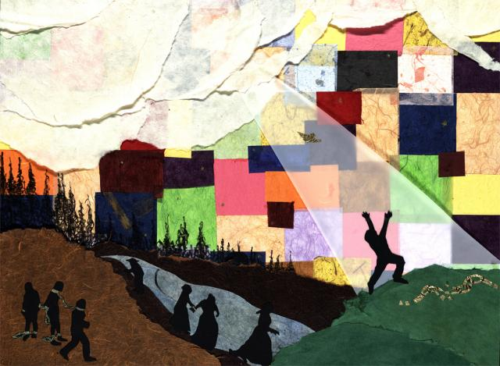

Slide 2
Literature Unit 5
*Bring your literature book and your composition book to class each day!
*Be ready for a quiz over each night’s story.
Be ready for an exciting tale each class hour!
Folktale and Epic

Slide 3
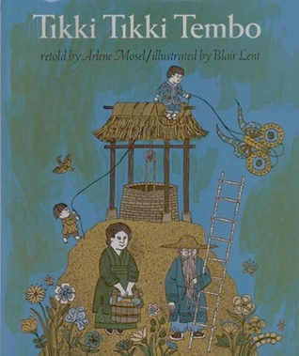
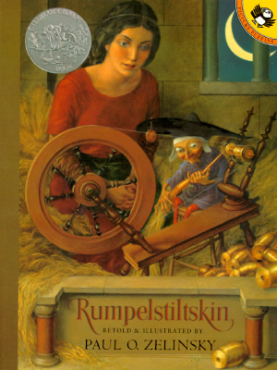
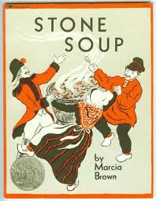
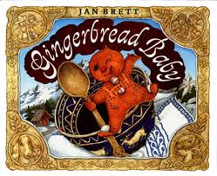
I. FOLKTALES
A short tale, usually anonymous, passed along by word-of-mouth

Slide 4
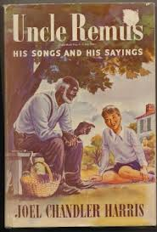
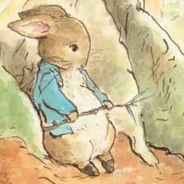
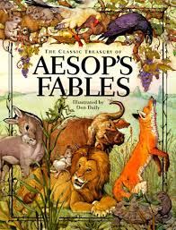
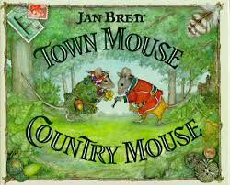
A. Fable
Brief fanciful stories that present a moral to teach about life through practical examples
Beast fable—most common type

Slide 5
B. Fairy Tale
A fictional story set in an indefinite time and place and containing an element of the fantastic or magical
Teach broad rather than focused lessons
Common theme: good vs. evil

Slide 6
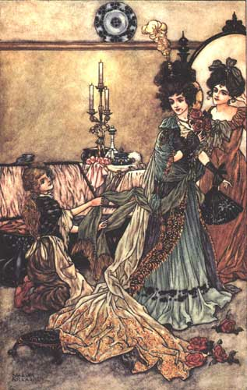
Snow White from Grimm’s Fairytales
Cinderella from French fairytale

Slide 7
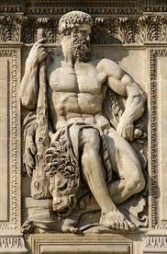
C. Myth
Stories that explain specific aspects of life or the natural world
A culture’s mythology explains how the world came to be as it is.
Most myths Greek or Roman in origin

Slide 8
II. EPIC
Long, stylized narrative poems celebrating the deeds of a national or ethnic hero of legend
Embodies its culture’s values and beliefs
Common themes: life and death, love, war, family, friendship

Slide 9
A. Four conventions of content
Setting is large
Unusually gifted and historically important hero
Supernatural elements
Superhuman actions, usually in battle or a difficult journey

Slide 10
B. Two types of epic
Traditional—sprang from oral poetry in illiterate cultures
Literary—epics devised by poets in imitation of traditional epics

Slide 11
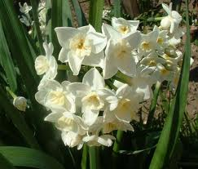
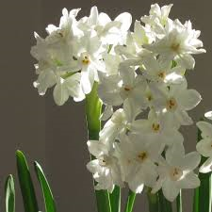
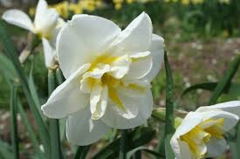
Narcissus & Echo

Slide 12
C. Four conventions of form
Statement of theme and invocation of the muse (a woman, or a force personified as a woman, who is the source of inspiration for a creative artist.)
In medias res (“in the middle” of the action)
Descriptive catalogues
Verbal formulas
a. Epic similes
b. Homeric epithets

Slide 13
III. “The Ant and the Grasshopper”
A. A Fable
Fables are different from parables in that the details of fables are a symbol as a unit. The individual parts of a fable are not symbolizing many various concepts.
Fables do NOT always state moral in the story text.

Slide 14
B. Symbolism
Ant—thrifty, resourceful one
Grasshopper—unthrifty waster
Seasons may equal stages of life OR times of prosperity and adversity
How can you apply this to your own life?

Slide 15
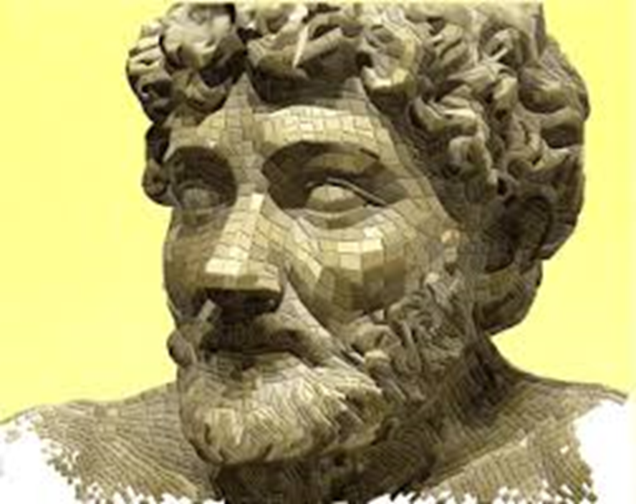
Aesop
Sixth-century Greek slave
born 620 B.C.(?)
Remembered for story-telling ability
Often thought to be the originator of the fable form

Slide 16
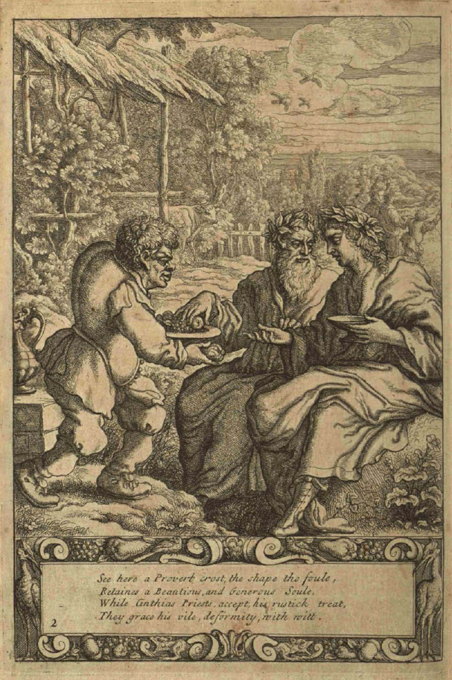
Various types of Aesop’s fables

Slide 17
V. “The Lion-Makers”
Indian folktale (and fable)
Part of a collection called the Panchatantra, a series of frame stories (a literary technique that sometimes serves as a companion piece to a story within a story, whereby an introductory or main narrative is presented, at least in part, for the purpose of setting the stage either for a more emphasized second narrative or for a set of shorter stories. The frame story leads readers from a first story into another, smaller one (or several ones) within it.

Slide 18
Characters
We know very little about them; they are _____________ characters.
Unsympathetic character: the eldest
Notes:
flat

Slide 19
Quiz: “The Lion-Makers”
1. From what country does this folktale come?
2. What do the four friends want to do?
3. One of the four men lacks learning but has what?
4. What do the three learned friends decide to do along the way?
5. After warning his friends, what does the fourth man (who lacks learning) decide to do?

Slide 20
Moral
Knowledge is useful, but if it is not guided by common sense, it can do more harm than good.
“Science is a first-rate piece of furniture for a man’s upper chamber, if he has common sense on the ground floor.”
Oliver Wendell Holmes Sr.

Slide 21
IV. “The Tortoise and the Osprey”
An African folktale that blends two folktale genres: ________ and ________
Tortoise’s foolishness illustrates a moral AND accounts for the criss-cross pattern on a tortoise’s shell
Notes:
Fable and myth

Slide 22
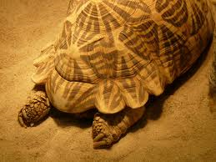
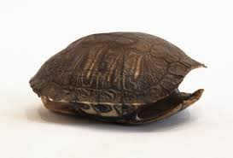

Slide 23
Characters
Kamba = a stock character (the idle dreamer)
Tortoise’s wife = a ________ character
Osprey and Chameleon reinforce Tortoise’s foolishness.
Notes:
foil

Slide 24
Atmosphere
_________________ because Tortoise finds the silver lining in his situation; he now feels that he has ______________.
Notes:
Lighthearted; prestige

Slide 27
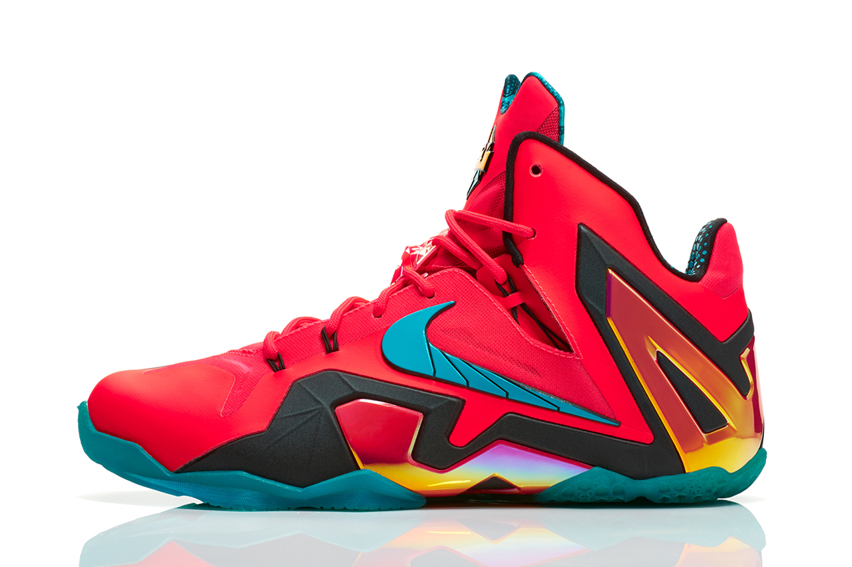
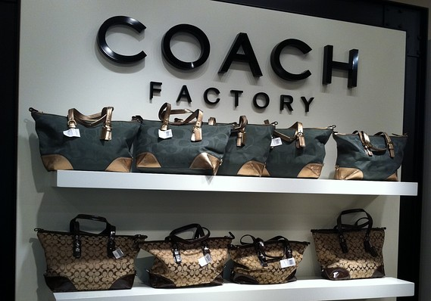

Slide 31
Moral
Be _____________ with who you are and what you have.
I Tim. 6:6— “Godliness with _____________ is great gain.”

Slide 32
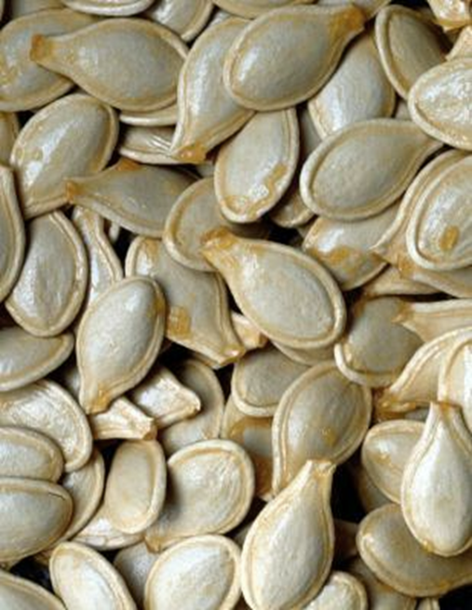
VII. “The Pumpkin Seeds”
Korean folktale
Fairy tale for the following reasons:
1. indefinite setting
2. indefinite time
3. magical elements
4. broad but clear moral boundaries

Slide 33
Archetype: recurring character types or plot patterns
This story contains archetypes of character and plot.
Two brothers, one good and one bad, one rich and one poor
Good rewarded and evil punished

Slide 35
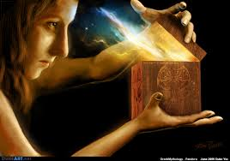
VI. “Pandora”
One of the most famous Greek myths
Primarily explains the origin of the first _____________ and how trouble came into the world
____________________: common allusion
Notes:
Woman; Pandora’s box

Slide 36
Characters
Pandora
*beautiful but fashioned from a blend of contraries
*good wife in general but too ____________
*remorseful
*caring
Notes:
Curious; nosey

Slide 37
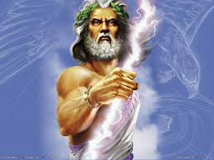
Prometheus: benevolent toward man
Zeus: cruel and vengeful
Epimetheus: impulsive and forgiving

Slide 38
Themes
The negative consequences of a lack of forethought
Availability of __________ to all mankind in a troubled world
Biblical worldview: hope … a gracious God whose mercies are new every morning!
Notes:
hope

Slide 39
Writing a Fable
Every fable has a moral, characters and some kind of conflict/resolution.
Look at your children’s book and write down in the back of your booklet the title of the book, the main character(s), the conflict and the moral.
“One Grain of Rice”
Let’s try coming up with our own fable elements.

Slide 40
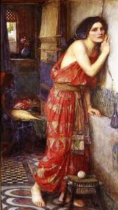
VIII. “Pyramus and Thisbe”
Roman myth first appeared in Ovid’s Metamorphoses (a long poem about transformations)
Proclaims the transformative power of love
Absence of supernatural forces but explains why mulberries are red
Used by Shakespeare in______________________ _______________________________ and ____________________

Slide 41
Characters in Literature … pg. 193
“Characters”—the persons or beings who perform the action of a story.
Protagonist—the main character, the one at the center of the main conflict.
Antagonist—a character or force who opposes the main character.
Sympathetic Characters—those with whom the reader identifies or feels feelings for
Unsympathetic Characters—ones with whom the reader cannot identify/has strong feelings of dislike
Character Motivations—the reasons characters behave as they do

Slide 42
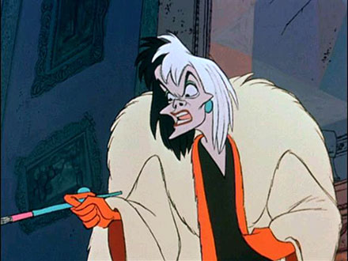
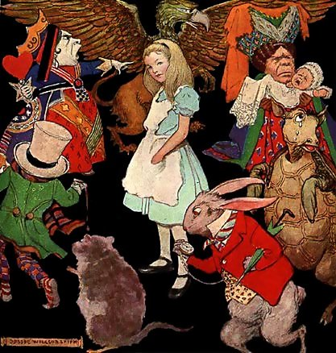
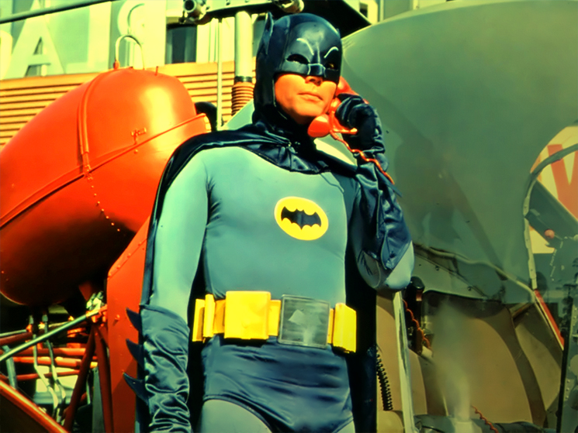
Famous Characters
Antagonist or Protagonist…
Batman
Cruella de Vil
Alice
Joker
Prince John (Robin Hood)
Villefort
Valentine

Slide 43
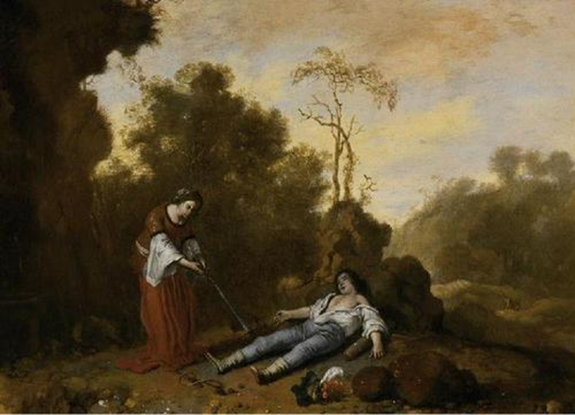
In Aesop’s tale, “Ant and the Grasshopper,” which is the sympathetic character?
Both Pandora and Epimetheus have personal flaws that affect the outcome of “Pandora.” Do you still sympathize with both? Why or why not?
Who are the protagonists and antagonists of “Pyramus and Thisbe”? With whom does the audience sympathize? Why?

Slide 44
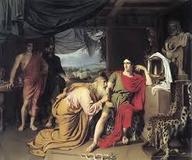
IX. The Iliad
Written by Homer during the _______ century BC
Setting: 12th century war between Trojans and Achaeans (Greeks)
Formal style
Use of Homeric __________ (a stock phrase inserted to describe a particular person or thing that recurs in a poem)
“Karina, slayer of men”
Notes:
https://www.youtube.com/watch?v=KlSanUPJTWU 8th century

Slide 45
Hector and Andromache
Hector:
a. views battlefield as a place of ______
b. loves his wife and son, but fighting is a ________ that takes precedence over his family
c. ________ bears his fate
Andromache:
a. domain is the ________
b. aims to __________ Hector’s life
c. ___________ towards fate
Notes:
Honor; duty; bravely
Home; preserve; resentful

Slide 47
Symbols
__Armor______: symbol of military strength
Hector’s helmet: symbolizes his role as ____warrior_____
Loom and the distaff: Andromache’s role in the __home___ as a hardworking wife
Notes:
armor

Slide 49
The Death of Hector
Theme: The anger of Achilles and its results for himself, his comrades, his enemies, and the war.
Kleos is also a theme (immortal fame)
Achilles’ tragic flaw=
Tragic flaw: a personal character flaw of the tragic hero.
Tragic hero: the protagonist (usually a sympathetic character) of a tragic story
Hector=Trojan
Achilles=Greek
Notes:
His excessive and prideful anger

Slide 50
While you listen, please find three Homeric epithets and three epic similes. You will turn this in at the end of the hour.
Notes:
Click on pic for Part One of Audio version of Death of Hector

Slide 51
Notes:
Audio book of Death of Hector … click on pic for Part 2

